Slide 1

Wharton Business Financial Modeling Capstone
Allen Zagorodnyuk

Slide 2
What to Expect
What is Portfolio Diversification?
Why is Portfolio Diversification Important?
Optimal Investment Strategy for VBTLX and VFIAX
Risk of Investing without Diversification

Slide 3
What is Portfolio Diversification
Portfolio Diversification is the act of spreading out (diversifying) an investment across a variety of different assets, sectors, industries, etc.
The goal of Portfolio Diversification is to create a strong enough portfolio that will not be impacted by crashes or large dips in a specific market.

Slide 4
Why is Portfolio Diversification Important
Portfolio Diversification is important because it allows us to invest in a wide variety of areas by pooling the risk in-order to decrease our total exposure.
By investing in a large variety of assets, we can maximize our investment by having access to more opportunities. Additionally, a diverse portfolio gives us the flexibility to move around and adjust our initial investment depending on market conditions.
A portfolio that is not diversified is highly probable to suffer from high volatility and risk.

Slide 5
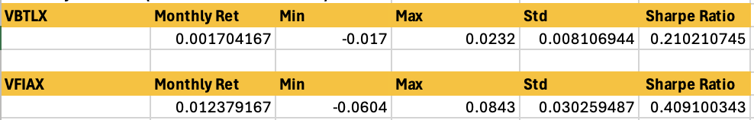
VBTLX and VFIAX
VBTLX: Vanguard Total Bond Market Index Fund
VFIAX: Vanguard 500 Index Fund
VBTLX and VFIAX are two funds that represent investment vehicles in fixed income and equity, respectively.
We will simulate a $5,000,000 optimal risky investment strategy using VBTLX and VFIAX
Below are Summary Statistics for VBTLX and VFIAX.

Slide 6
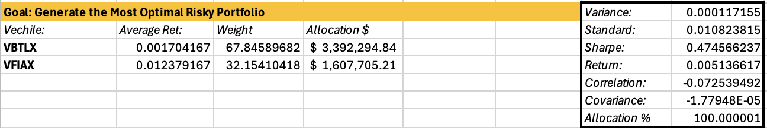
Optimal Strategy Calculations I
Summary Statistics and Monthly Return Data from VBTLX & VFIAX were used to generate the following data.
Using the the Solver Function in Excel, we maximized the Sharpe Ratio.
Sharpe Ratio = ((Expected Return – Risk Free Rate)/Standard Deviation).

Slide 7
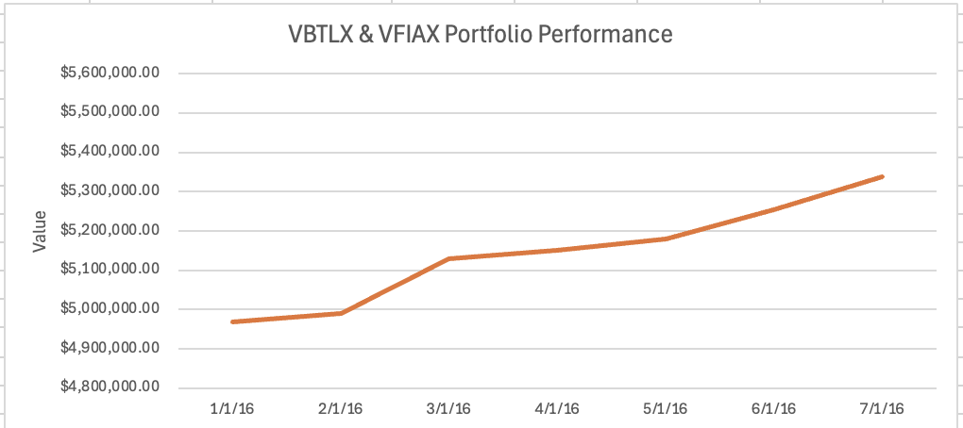
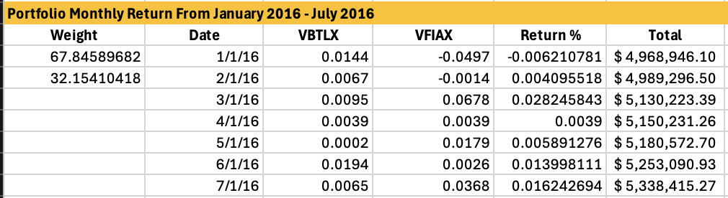
Optimal Strategy Calculations II
Using the generated percentages we calculated the monthly return and total return of our investment
At July 1st 2016, our initial investment increased by over $300,000.
See the charts below to see the monthly change in our initial investments value.

Slide 8
Optimal Investment Strategy
According to our calculations the optimal risky investment strategy for our diversified portfolio, with $5,000,000 in capital, is the following:
VBTLX: 67.85%, $3,392,294.82
From January 2016 – July 2016 the expected portfolio gain is 6.76%, and the ending portfolio value will be $5,338,415.27.
This portfolio has a Sharpe Ratio of 0.475.
VFIAX: 32.15%, $1,607,705.18

Slide 9
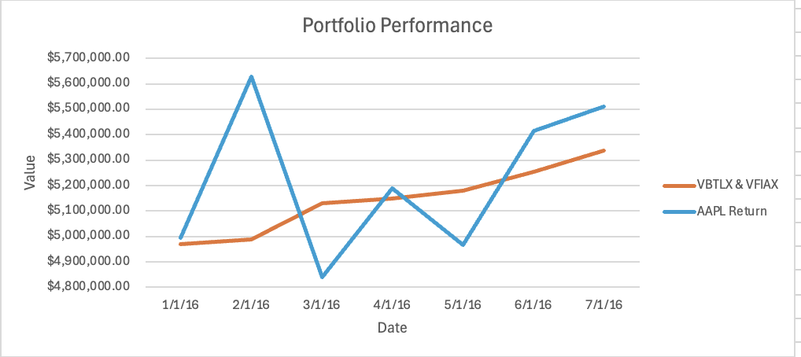
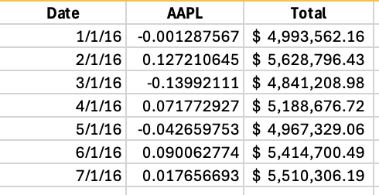
Danger of Investing without Diversification I
If we do not diversify our portfolio we open ourselves to greater risk and uncertainty.
Investing all available capital without diversifying will allow one asset to determine all-of our return, minimizing our potential.
Ex: Investing $5,000,000 into Apple from Jan 2016 – July 2016.

Slide 10
Danger of Investing without Diversification II
At the end of the investing period, the gain from Apple surpasses the gain from VBTLX & VFIAX. However, this simulation assumes that we hold Apple, and aren’t forced to sell when Apple’s stock fell, and showed us losses of $200,000.
Additionally, if we wanted to maximize our return from Apple, we would have sold it in the second month.
Overall, investing in Apple may have led to an over higher gain during the investment period, however this gain came after a large amount of volatility and risk. If we had invested in another single security there is no guarantee that we would see the same results.

Slide 11

Findings and Observations I
Portfolio Diversification is the act of investing in a large variety of assets in different industries.
It is important to diversify because it lowers risk and volatility, while increasing potential.
Our investment strategy maximizes the Sharpe Ratio at 0.475.
VBTLX: 67.85%, $3,392,294.82
VFIAX: 32.15%, $1,607,705.18
Return: 6.76%, $338,415.27 gain

Slide 12
Findings and Observations II
Investing in a single security may lead to larger returns, but the probability of such an event is unlikely. Additionally, holding just one security will lead to a large variance in your portfolio’s performance.
To conclude, it is safer, more reliable, and more flexible to have a diversified portfolio instead of investing all your capital into one asset. Our findings support this conclusion, as our diverse portfolio generated a constant and steady increase over the investment period, while our investment in Apple experienced large surges in both the upward and downward direction.

Slide 13
Thank you!
Allen Zagorodnyuk
alz4467@nyu.edu

